Slide 1
Networking in the Cloud

Slide 2
What is PaaS?
PaaS vs. IaaS vs. SaaS vs. FaaS

Slide 3
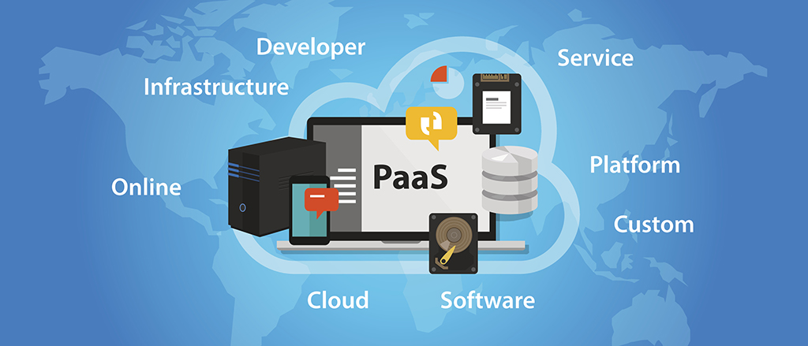
In the traditional software development lifecycle, developers often grapple with complex infrastructure setup, server provisioning, and ongoing maintenance tasks. This process tends to slow down application development and deployment, diverting valuable time and resources from more high-impact work.

Slide 4
Developers who don’t need to customize their underlying infrastructure and want a fast, easily managed, and readily scalable way to develop their application often choose PaaS (Platform as a Service). PaaS is a great way to host mobile and web applications and static sites. Often, developers want to spend their time and energy working on their idea—whether that’s a mobile app or a website or blog. PaaS offerings allow developers to boost productivity and spend their time on what matters most to them. Read on to explore the benefits of PaaS, its various use cases, and advice on choosing the right PaaS solution for your needs.

Slide 5
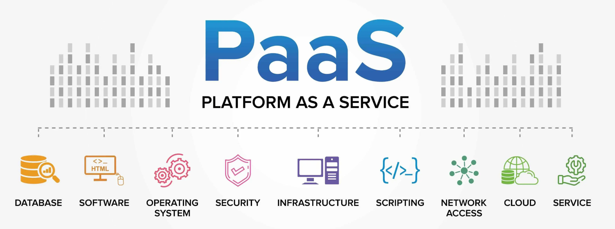

Slide 6
What is PaaS (Platform as a Service)?
Platform as a service, or PaaS, is a category of cloud computing that allows developers to use deployment platforms to build, deploy, and scale their applications. When a developer uses PaaS, all they have to consider is their code. With PaaS, the cloud provider provides all the backend infrastructure, including networking, middleware, servers, storage, virtualization, the OS, and the runtime environments.
This means that users can expect pre-configured runtime environments and predictable scaling, storage, and security options. Users have access to certain libraries, tools, and configuration settings, but they can’t modify the underlying operating system or network settings. PaaS products make it easier to scale, rapidly iterate, and quickly deploy.

Slide 7
PaaS vs. IaaS vs. SaaS vs. FaaS: What’s the difference?
It’s hard to think about PaaS without also considering the other delivery models for cloud computing, specifically Infrastructure as a Service (IaaS), Software as a Service (SaaS), and Functions as a Service (FaaS). There are fundamental differences to each delivery model and pros and cons for each depending on the user’s needs. Let’s dive in:
IaaS
IaaS models provide on-demand computing resources over the internet, including networking, storage, and other infrastructural components. With IaaS, users have complete control over their infrastructure and the software and tools associated with their tech. Still, they don’t have to control or manage the physical infrastructure, like bare metal servers or data centers.

Slide 8
PaaS vs. IaaS vs. SaaS vs. FaaS: What’s the difference?
With IaaS, users can choose the level of control over their infrastructure, but they don’t have to control or manage the physical hardware. Developers can set up their infrastructure and decide what layers of abstraction they want. IaaS providers like DigitalOcean offer a comprehensive suite of cloud services including virtual machines (Droplets), Managed Kubernetes, Managed Databases, Spaces object storage, and more.

Slide 9
PaaS vs. IaaS vs. SaaS vs. FaaS: What’s the difference?
PaaS
With PaaS, users no longer have to manage the operating system, runtime, or other infrastructural components of their application that they would need to manage with IaaS. PaaS provides a fully managed solution for developers looking to launch applications quickly. When developers choose to use PaaS, they can focus on their development work and let the provider manage backend services and system administration.

Slide 10
PaaS vs. IaaS vs. SaaS vs. FaaS: What’s the difference?
SaaS
SaaS goes further and provides the user with an interface that is easy to use without the user having to worry about any backend components. SaaS applications are popular because of their simplicity and accessibility. Many consumers are familiar with SaaS applications as they are popular ways to deliver software. Some widely-used SaaS tools include Salesforce for customer relationship management, Google Workspace for productivity, Slack for team communication, and Zoom for video conferencing.

Slide 11
PaaS vs. IaaS vs. SaaS vs. FaaS: What’s the difference?
FaaS
Serverless architecture or Functions as a Service (FaaS) is used for specific functions that are event-driven and can be fully managed by the cloud provider. They execute on code written by the user and are triggered by a particular event. The results of that execution are then sent to the user. This allows businesses to pay per request rather than pay for an entire ongoing structure.

Slide 12
How do PaaS solutions work?
PaaS providers offer a comprehensive environment for application development, deployment, and management in the cloud. These platforms abstract away the complexities of infrastructure management, allowing development teams to focus on writing code and building applications. PaaS solutions typically integrate various development tools, frameworks, and services to streamline the software development lifecycle. Here’s how it works:
Infrastructure abstraction.
The PaaS vendor manages the underlying infrastructure, including servers, networking, and storage. This abstraction allows developers to deploy applications without worrying about the intricacies of infrastructure configuration and maintenance.

Slide 13
How do PaaS solutions work?
Development environment.
PaaS providers offer integrated development environments (IDEs) and development capabilities tailored to specific programming languages and frameworks. These environments often include version control, testing tools, and collaborative features to enhance productivity.
Middleware and services.
PaaS solutions typically include pre-configured middleware, databases, and other services. Developers can easily integrate these components into their applications, reducing the time and effort required for setup and configuration.

Slide 14
How do PaaS solutions work?
Scalability and resource management.
PaaS platforms handle automatic scaling and resource allocation based on application demands. This ensures the best performance possible and efficient use of cloud computing services without manual intervention.
Deployment and monitoring.
PaaS providers offer streamlined deployment processes, often with continuous integration and delivery (CI/CD) pipelines. They also provide cloud monitoring and logging tools to help developers track application performance and troubleshoot issues.
The modular nature of PaaS allows development teams to pick and choose the components and services that best suit their project requirements.

Slide 15
Benefits of using PaaS
Platform as a Service is transforming how software teams work, offering advantages that go beyond convenience. Its adoption is driving shifts in how organizations approach the entire lifecycle of application development and deployment. Here are some of the benefits:

Slide 16
Accelerated time-to-market
PaaS reduces the time required to bring applications from concept to production. By providing pre-configured development environments and streamlined deployment processes, it eliminates many time-consuming setup and configuration tasks. This acceleration helps businesses to respond more swiftly to market demands and stay ahead of competitors—even if that means a business pivot. The ability to rapidly prototype, test, and deploy applications can be a critical differentiator when competing with other startups in your space.

Slide 17
Cost optimization
PaaS offers a more flexible and efficient cost model compared to traditional infrastructure investments. The pay-as-you-go approach aligns costs with actual usage, eliminating the need for significant upfront capital expenditure. This model reduces initial investments while also reducing operational costs by automatically scaling resources based on demand. Plus, PaaS providers handle maintenance, updates, and security patches, reducing your reliance on dedicated IT staff, leading to additional cost savings in the long term.

Slide 18
Simplified scalability and management
One of the standout features of PaaS solutions is their ability to provide seamless scalability, allowing applications to handle varying loads without manual intervention. This automatic scaling helps stabilize performance during traffic spikes while maintaining cost-efficiency during quieter periods. Plus, PaaS platforms typically include comprehensive monitoring and management tools, providing developers and operations teams with deep insights into application performance and usage patterns. These capabilities facilitate proactive optimization and troubleshooting, enabling teams to maintain high-quality service levels with less effort and resources.

Slide 19
What are the use cases for PaaS?
PaaS solutions enable more than simple web development. Instead, they offer the flexibility for a host of different use cases:
Rapid prototyping and MVP development
PaaS is valuable in scenarios where speed-to-market is important. Startups and innovation teams can leverage PaaS to quickly build and deploy minimum viable products (MVPs) without the overhead of managing complex infrastructure. The pre-configured environments and built-in development tools allow developers to focus on core functionality, reducing the time from concept to working prototype. This is particularly helpful in competitive markets where being first can make a significant difference.

Slide 20
Mobile development
PaaS platforms have become increasingly popular for mobile app development, offering specialized tools and services tailored to mobile environments. They provide backend services, push notifications, and data sync capabilities. PaaS solutions also often include cross-platform development tools, allowing developers to build apps for multiple mobile operating systems from a single codebase.

Slide 21
API development and management
PaaS provides robust tools for creating, testing, and deploying APIs at scale. These platforms often include features like API gateways, rate limiting, and analytics, allowing developers to easily manage API lifecycles. PaaS solutions also facilitate the implementation of security protocols and versioning, ensuring that APIs remain reliable and secure as they evolve.

Slide 22
Factors to consider when choosing a PaaS solution
Users of all kinds can benefit from the power and flexibility that PaaS provides. However, when deciding what solution is best for your business and goals, consider these factors:
Loss of user control and visibility
PaaS is optimized for ease of code deployment rather than deep customization of the underlying infrastructure. If users need more visibility into and control of the infrastructure, PaaS may not be the right solution. Teams that want complete control over their production environment and the design and behavior of their infrastructure should consider using an IaaS solution.

Slide 23
Vendor lock-in
When selecting a PaaS solution, consider the potential for vendor lock-in, which can limit your flexibility and scalability in the long run. Vendor lock-in occurs when your company becomes overly dependent on a specific PaaS provider’s proprietary technologies, making it difficult and costly to switch to another provider or migrate to a different cloud infrastructure.
To mitigate this risk, look for PaaS solutions that support open standards, offer easy data portability, and provide clear exit strategies. It’s also wise to evaluate the provider’s commitment to interoperability and their track record of supporting industry standards. Using open-source cloud solutions makes it easier to migrate computing operations from one provider to another.

Slide 24
Cost
Opting for a PaaS solution may seem expensive in the beginning. While it is initially more costly to use a PaaS than to build something yourself on an IaaS solution, users often find they save money with PaaS over time, especially accounting for hours spent managing the infrastructure of applications. PaaS solutions typically include built-in cloud cost optimization features, such as automatic scaling and resource allocation, which can lead to more efficient use of resources and reduced overall cloud spending.

Slide 25
Regulation
PaaS uses cloud computing for its infrastructure, which means that it’s essential to consider how data is collected and stored and what regulations you may be facing with your customer data. Some industries, like healthcare and finance, have strict rules about storing and using customer data and may not allow customer data to be held in public clouds. Organizations also need to consider the data protection and privacy laws in the location where their services are used.

Slide 26
Security and data considerations
All the major cloud providers, are regulated and have strict security requirements, along with entire security teams and other experts dedicated to keeping information safe. Still, cloud services are open to some security threats. While these instances are extremely rare, it’s a good idea to find out how the cloud service provider secures data and how they recommend customers further secure their data.
Providers may also use your data for things like understanding the use of their product, selling or personalizing ads, or training machine learning algorithms. Find out what a provider’s policies are for using and deleting data before giving them access.

Slide 27
Thank You !!!

